Slide 1
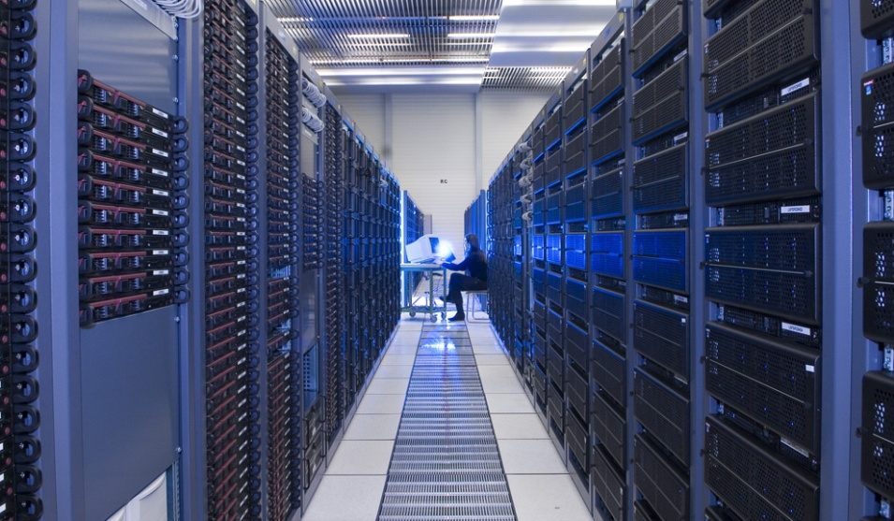
Introduction to
Cloud Computing

Slide 2
Introduction
Cloud computing refers to the on-demand provision of computational resources (data, software) via a computer network, rather than from a local computer
The cloud makes it possible for you to access your information from anywhere at any time. While a traditional computer setup requires you to be in the same location as your data storage device, the cloud takes away that step. The cloud removes the need for you to be in the same physical location as the hardware that stores your data.

Slide 3
Types of Cloud
Public cloud:
A public cloud is one based on the standard cloud computing model, in which a service provider makes resources, such as applications and storage, available to the general public over the Internet. Public cloud services may be free or offered on a pay-per-usage model.
Private Cloud:
Private cloud is the implementation of cloud services on resources that are dedicated to your organization, whether they exist on-premises or off-premises.

Slide 4
AWS Introduction
Amazon Web Services (AWS) is a collection of remote computing services (also called web services) that together make up a cloud computing platform, offered over the Internet by Amazo.com. The most central and well-known of these services are Amazon EC2 and Amazon S3.
Amazon Web Services (AWS) has provided companies of all sizes with an infrastructure web services platform in the cloud
Amazon Web Services delivers a number of benefits for IT organizations and developers like
Cost-effective - Pay only for what you use
Dependable - giving you reliability and massive scale.
Flexible- Build any application you want using any platform or any programming model
Comprehensive- Build any application you want using any platform or any programming model

Slide 5

Thank You

